Slide 1

O365 Calendar incl. Webex Meetings Web Scheduler
GVE DevNet
Global Sales Segment : Global Commercial and Small
Industries : Health Care
LoB : Operations Automation
Architectural Plays : Collaboration
Sales Plays : Modernize the Workforce Experience for Enterprise
Jara Osterfeld
Technical Solutions Specialist
August 2020
Notes:
Notes: If your use case applies to morer than one or even all industries please keep all the industries and BOLD the industry where the PoV fits.
Smart City/Health Care/Industry and Manufacturing/Hospitality/Education/Retail/Utilities/Logistics/Professional Services/Public Sector/Service Provider
For LoB applies the same : if there is just one LoB, delete others, and bold the LoB that PoV is about.
LoB ; Safe and Security/Operations Automation/Human Resources/Operation Analytics
Please only keep the Architectural Plays that PoV is about.
Architectural Play : Enterprise / Data Center / Security / Collaboration / Service Provider

Slide 2

Healthcare/Insurance
Operations Automation
Notes:
Please under Industry Alignment just types the Industry that PoV was created as well LoB
For the pictures, when you go to the bx.cisco.com link and select brand categories and the select photograpy you can use the engine text box to look for industry pictures and download it

Slide 3

O365 Calendar incl. Webex Meetings Web Scheduler
Business Needs/Challenges
Need: The customer is looking for a video conferencing solution with high security standards and flexible APIs to integrate the solution into existing and automated workflows.
Challenge: The solution must be able to programmatically schedule meetings and send the information in an O365 calendar invite.
[Portal] - Business Case information
Solution
Using a simple web page, Webex Meetings can be scheduled and O365 calendar invites sent. Given the right permissions, users can also schedule a meeting on behalf of another user.
[Portal] – Introduction information
Business Outcomes
The customer can easily integrate the video conferencing solution into existing and automated workflows. This provides them with a flexible solution that also fulfills their high security requirements.
Notes:
Notes :
At the top Select a short name of the PoV naming product or products involved
Insert the logo f the customer when applies (if it is a general use case ignore the insert logo)
For Business Needs/Challenges :
For bullet Need : Write a small sentence that in an objective way to express the problem to solve when you refer to this problem, avoid to use technical words, uses business language as C-Level
For bullet Challenge : Write the main challenge and drawback the customer has to solve the problem (also avoid technical words, make a message in C-Level)
Solution :
Describe in a small sentence what is the solution about to deal with the problem referred, again, please avoid to uses technical words and use C-Level language
Business Outcomes:
Use small paragraph to show the benefits and gains with the solution explained above, please avoide to uses technical words and use C-Level language

Slide 4
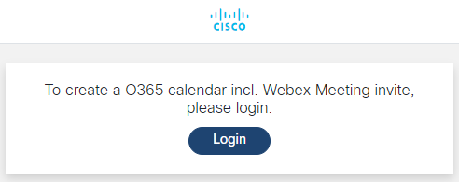
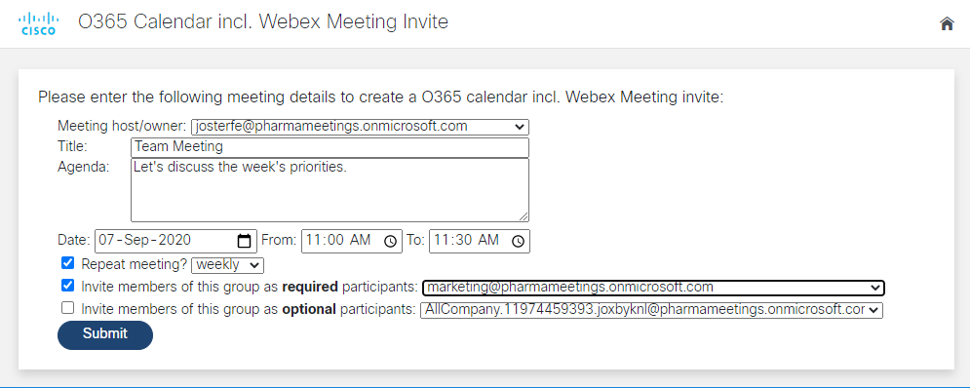
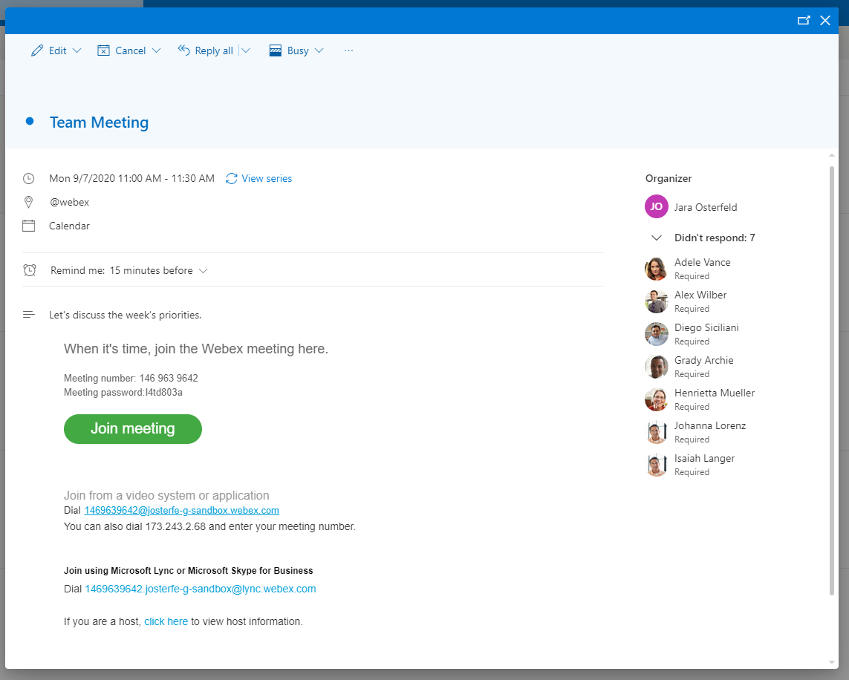
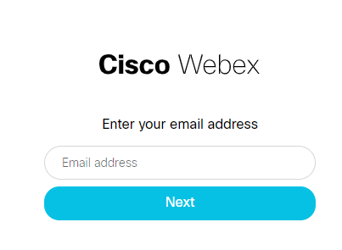
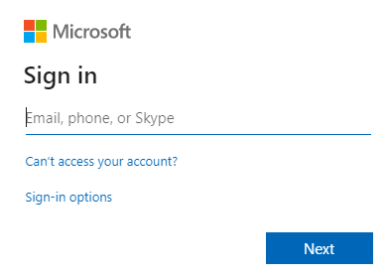

O365 Calendar incl. Webex Meetings Web Scheduler
scheduling a meeting using a simple web page
Login
O365 Calendar incl. Webex Meeting is scheduled
Provide Meeting Information
The user can now access the web form to enter the meeting information and select a group of meeting participants. He/she can also choose to schedule the meeting on behalf of someone else (given the user has the necessary permissions).
Once submitted, an O365 meeting invite is created, incl. the details to the Webex Meeting. The invite is sent to the chosen group of participants.
A user wants to schedule a meeting for a group of people in his organization. He/she visits the website and logs in. He/she is redirect to login to Webex and O365.
Notes:
Notes :
Use this slide to explain the story around your solution. It is a prototype in high level point of view. Think about a explanation of your solution to an executive that does not know Cisco and deep dive technology
This slide it is also to share knowledge with a non-technical guy (like BDM or sales or C-Level) what is the solution about and how will work . You can do as many steps as you need to describe the main flow of the solution
LINK for Icons https://www.flaticon.com/

Slide 5
POV: O365 Calendar incl. Webex Meetings Web Scheduler
Customer / Opportunity
Pharma.be is a Belgian organization representing more than 130 pharmaceutical companies. When meeting with their customers and partners, they often make use of videoconferencing tools. Today, they are using Microsoft Teams but are looking for a more secure solution.
What is the story? What was the business challenge?
On the organization’s intranet site, there is a web form, where employees can enter the meeting details and send it to a selected group of participants. The customer would like to keep this workflow, and that is why a key criteria for the new solution is the ability to programmatically schedule meetings and send them in a calendar invite.
What the PoV accomplished?
The application allows to schedule Webex Meetings and to send O365 calendar invites through a simple web page. Given the right permissions, users can also schedule a meeting on behalf of another user.
[Portal] - What the PoV accomplished?
What are the benefits to the customer?
The customer maintains their existing workflow while having implemented a more secure solution.
Notes:
Notes :
*** From the side to the rest you can use all technical wording and reference from Cisco APIs, integrations and tools
Please fill the slide thinking about technical people and the scope of this PoV (what it is cover from the solution proposed and if there is a limitation or need a special integration to be awared
Align the bullet
What are the benefits to the customer?
With the Business Outcomes that you explain in the business case slide. And also you can add technical benefits on this slide or future steps to be added later as following steps

Slide 6

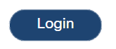
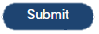


High Level Design PoV
authentication workflow
scheduling workflow
1. User visits page to login
2. Redirect to Webex login
5. User fills in meetings form
6. Webex Meeting is created
7. O365 invite is created and sent, incl. Webex Meetings details
3. Redirect to O365 login
4. User is granted access to meetings form
https://wwwin-github.cisco.com/gve/O365_WebexMeeting_WebScheduler [Portal Link]
Notes:
Notes:
Describe the High level design and flow for the PoV and mentioned the tools used
Do not forget to add the link to github repository or other specifcs needs

Slide 7
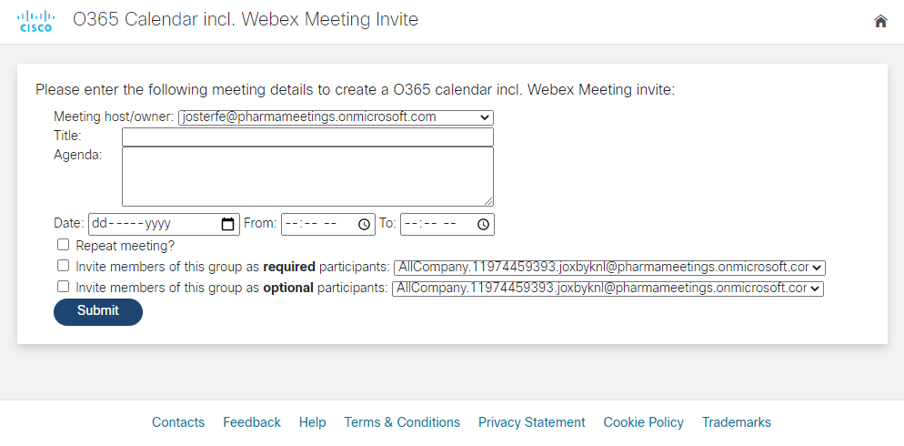
Show GUI or mockup
https://youtu.be/nSuJnPsAC2g [Portal Link]
Notes:
Notes :
Some of the PoVs are developed either Sandboxes from dcloud, devnet or customer premises lab.
In the case the PoV is execute under Customer Premises Lab and would be hard to replicate the PoV, Please record video with the Demo and add the link to it.

Slide 8
Tools (products) Used
[Portal] - List of products and tools used in project:
Python, Flask, Webex (REST and Meetings XML API), Microsoft 365, HTML
Add link to the presentation url. [Portal Link]
Notes:
Notes :
Describe all the tools,
If there is a need for a specific licenses or code versión or hardware specifications mentioned here

Slide 9
Check out the GVE Devnet team @
https://gve-devnet.cisco.com/
Open a GVE case @
https://cep.cloudapps.cisco.com/case

